Slide 1
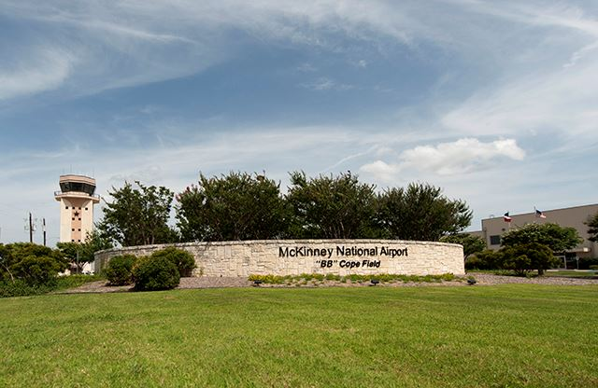
McKinney Airport
Master Plan
Update
May 1, 2018
Paul Hendricks
phendricks@fairviewtexas.org
pmh1004@sbcglobal.net
469-667-7750

Slide 2
McKinney Airport Master Plan
The recommended Master Plan Concept for proposed development potential over the next 20+ years
A detailed Capital Improvement Program associated with potential airport development
An environmental overview of the proposed development
Airport Master Plan Update Study is a Recurring FAA Requirement to ensure Airport Readiness and Adequacy for Future Capacity

Slide 3
Phased Funding Profile
Short Term (1 – 5 years): $124,000,000
Construct General Aviation Terminal (EDC/CDC Support)
Acquire Land
Extend Hangar Taxilane access
Extend Runway 18-39 1,500’
Intermediate Term (6 – 10 years): $37,000,000
Lighting, Hangar access
Long Term (11 – 20 years): $383,000,000
Construct Parallel Runway
Construct Commercial Service Complex
Construct Parking Complex
Taxiway Modifications
Total Program: $544,000,000

Slide 4
Action Item Update
Maintain interface with McKinney staff
Status: Met with Airport Manager Ken Carley on April 24
Attendees: Julie Crouch, Ray Dunlap, Paul Hendricks
Summary:
Master Plan still in review and anticipate some changes
Focus on economic input and value: best uses of the airport
New runway may not be needed for 20+ years
Runway extension – heavy weight take-offs
Economic impact studies – underway
Environmental impacts studies will be required for all updates
Current efforts: New General Aviation Terminal and additional hangar (40K sq ft)
Anticipate presentation to McKinney Council Summer 2018
Requested continued interface with Fairview - information

Slide 5
Action Item Update
Maintain interface with McKinney staff: Update Airport Advisory Team
Status: Ken Carley Met with Advisory Team on April 24
Attendees: John Wroten, Howard Robbins, Maryanne Simonsen
Summary:
Noise discussions
Will review Standard Instrument Departure routes
Coordinate with Tower manager for procedures and coordination
Real Estate Values
Unknown residential impacts
Forecast positive commercial impacts

Slide 6
Next Steps
Update full Airport Advisory Committee
Maintain relationship with McKinney staff

